Slide 1



A
Experiments
Action
Action
Arena
Arena
Agent
Agent
Observation
Observation
Theoretical model

Slide 2
A
B
C
D

Slide 3
A
B
C
Notes:
Change the color to the inferno
Change experiment and maybe place cells, or merging

Slide 4

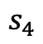
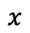
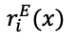

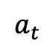
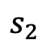

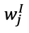
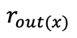


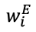
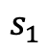
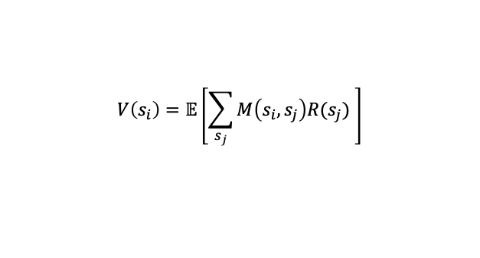
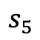
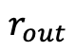

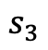
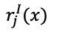
A
B
Excitation
$$a_{t}$$
Cognitive map
$$V\left(s_{i}\right)=𝔼\left[\sum_{s_{j}}{M\left(s_{i},s_{j}\right)R(s_{j}) }\right]$$
$$…$$
C
$$w_{i}^{E}$$
$$r_{i}^{E}(x)$$
$$M(s_{j},s_{5})$$
$$r_{out}$$
Relational memory
$$r_{out(x)}$$
$$s_{1}$$
$$s_{2}$$
$$s_{3}$$
$$s_{4}$$
$$s_{5}$$
$$w_{j}^{I}$$
$$r_{j}^{I}(x)$$
$$x$$
$$…$$
Inhibition
Sensory data

Slide 5
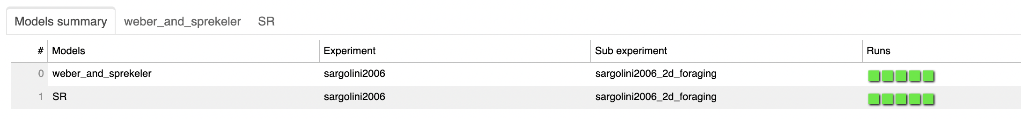
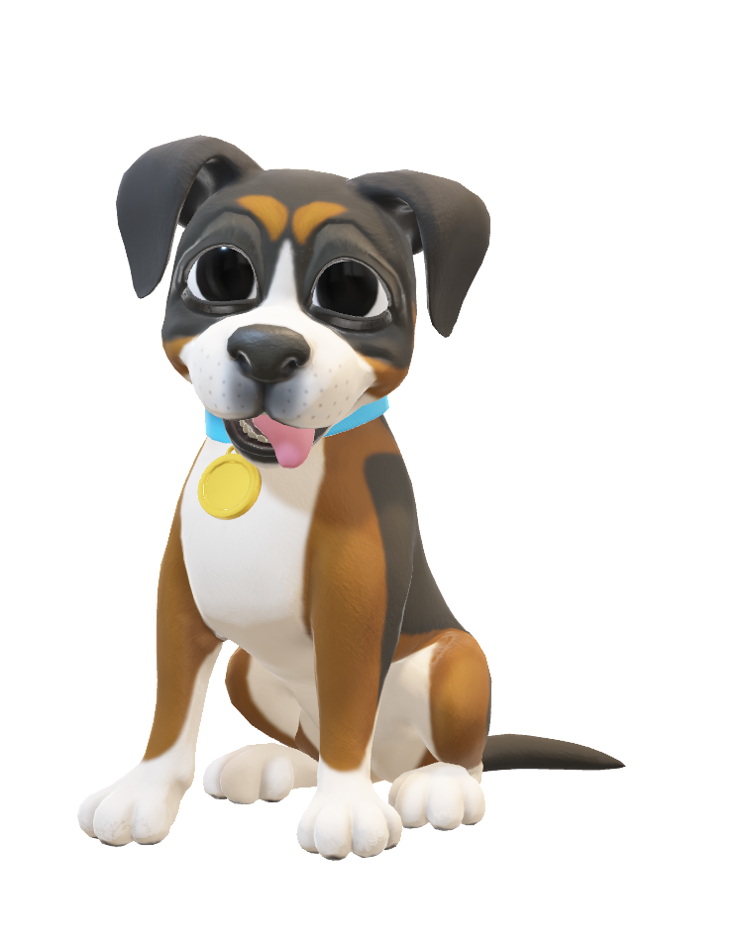
A
Models
Experiments
Sub experiments
Runs/Instances
B
Notes:
Do we want to have one less level ?

